Slide 1
Using AI in Your Coursework
SOE Student AI Guidelines
School of Education | Regent University
A shared framework for responsible, integrity-centered AI use
Notes:
Welcome faculty. This deck walks through the revised SOE Student AI Guidelines one-pager, reflecting updates made based on faculty committee feedback. Each slide corresponds to a section of the document students receive. Estimated presentation time: 15-20 minutes.

Slide 2
Why This Guide Exists
1
2
3
AI is Here
Policies Vary
Our Calling
Students in graduate programs are already using AI tools. The question is not whether you use them, but whether you use them wisely.
Permissions differ by course, assignment, and professor. This guide applies only when a professor has explicitly stated that AI use is permitted.
As a Christian institution, we are called to form scholars who exercise discernment, not just comply with rules. This guide is formational, not merely regulatory.
Notes:
Explain the origin of this document: developed with input from SOE post-master's students and reviewed by the SOE AI Committee. Emphasize that the guide complements your course-specific AI policy; it does not replace it. Students should always check the syllabus first. This guide sets the floor, not the ceiling.

Slide 3
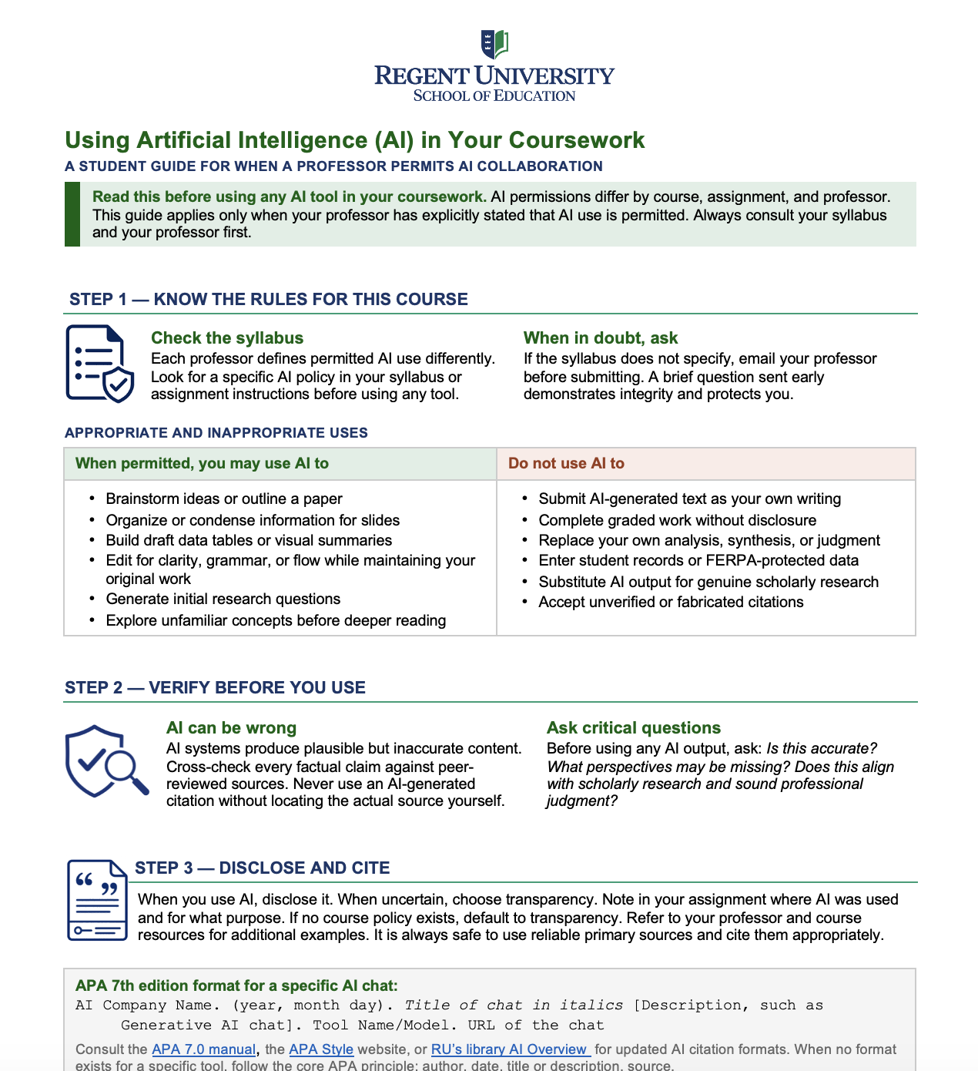
SOE Student One-Pager
Notes:
Open and show the students the document. You might choose to walk through Steps 1-3 just using the document instead of slides 4-6. Step 3 has additional examples to expand on the citation information.

Slide 4
Step 1: Know the Rules for This Course
Check the Syllabus First
When in Doubt, Ask
Each professor defines AI permissions differently. Students should look for:
Encourage students to email you before submitting, not after a concern arises.
An explicit AI policy statement
Assignment-level instructions
Disclosure and citation requirements
Any prohibited tool categories
"A brief question sent early demonstrates integrity and protects you."
Notes:
Note the revised word order in the guide: 'demonstrates integrity and protects you' places integrity before self-protection. This reflects the document's formational intent. Remind students that if the syllabus is silent on AI, that is a prompt to ask, not permission to proceed.

Slide 5
Appropriate and Inappropriate Uses
When Permitted, Students May Use AI To
Do Not Use AI To
Brainstorm ideas or outline a paper
Organize or condense information for slides
Build draft data tables or visual summaries
Edit for clarity, grammar, or flow while maintaining your original work
Generate initial research questions
Explore unfamiliar concepts before deeper reading
Submit AI-generated text as your own writing
Complete graded work without disclosure
Replace your own analysis, synthesis, or judgment
Enter student records or FERPA-protected data
Substitute AI output for genuine scholarly research
Accept unverified or fabricated citations
Notes:
The editing bullet has been updated from the previous version. It now reads: 'Edit for clarity, grammar, or flow while maintaining your original work.' This addresses the faculty concern that students could use AI editing as a backdoor to rewriting. Emphasize that the original ideas, argument, and voice must remain the student's own. Also: FERPA applies absolutely. No student names, IDs, grades, or records in any third-party AI tool.

Slide 6
Step 2: Verify Before You Use
AI systems produce plausible but inaccurate content. Polished language does not equal accurate information. Cross-check every factual claim against peer-reviewed sources. Never use an AI-generated citation without locating the actual source yourself.
Ask These Questions Before Using Any AI Output
1
Is this accurate?
Verify every factual claim. AI can hallucinate sources, statistics, and dates.
2
What perspectives may be missing?
AI outputs reflect patterns in training data. Minority perspectives, recent scholarship, and nuanced arguments may be absent.
3
Does this align with scholarly research and sound professional judgment?
Graduate students bring expertise. AI should support your thinking, not replace it.
Notes:
The third critical question now reads 'scholarly research and sound professional judgment' per the revised document. Note for the committee: the document retained 'AI systems produce plausible but inaccurate content' rather than the suggested 'convincing but inaccurate or incomplete.' That revision remains worth considering in the next edit cycle, since the stronger wording better captures the real risk — that AI sounds authoritative while still being incomplete or missing nuance.

Slide 7
Step 3: Disclose and Cite
When uncertain, choose transparency. Disclosure builds credibility; omission risks it. Make sure you check an assignment for any AI Use Disclosure Statement requirements.
APA 7th Edition Format for an AI Chat When Allowed
AI Company Name. (year, month day). Title of chat in italics [Description, such as Generative AI chat]. Tool Name/Model. URL of the chat
Example:
Anthropic. (2025, March 14). AI policy analysis for educational contexts [Generative AI chat]. Claude 3 Sonnet. https://claude.ai/chat/...
Note: Shared chat URLs are only accessible to the account that created the chat. A cited URL does not guarantee you can verify the interaction. Professors may require screenshots or pasted transcripts if they need to review a student's AI use.
Notes:
The disclosure language was updated to 'When uncertain, choose transparency' — cleaner and more direct than the previous version. The guide also added: 'Refer to your professor and course resources for additional examples' and 'It is always safe to use reliable primary sources and cite them appropriately.' Walk students through the APA format with the sample citation. The yellow note is for your awareness: AI chat URLs require the originating account to view them. If you need to audit a student's AI interaction, ask for a transcript or screenshot.

Slide 8
Step 3: Disclose and Cite Scenarios
When editing, revising, analyzing, or organizing your work with an AI tool –> use in-text citations and a reference
Reference Example:
OpenAI. (2025). ChatGPT [Large language model]. https://chatgpt.com
When using AI to help create a figure, table, other visuals, or media
Note. Image generated by ChatGPT (OpenAI, 2025). Prompt: [create a graph showing fourth-grade student reading NAEP data over the past five years]. Generated [May 30, 2025]. https://chat.openai.com
Note
Example:
* This would also be added as an AI tool in the References
Citing an AI tool in general, not a specific chat
Reference
Example:
Perplexity AI. (2025). Perplexity [Large language model]. https://www.perplexity.ai
APA Style does not require citations to common software
Notes:
This page has some cases related to citing AI

Slide 9
A Note on Integrity
“Get wisdom; develop good judgment.”
— Proverbs 4:7 (NIV)
This reminds us that learning requires human judgment, careful testing, and thoughtful application.
AI is a resource, not a co-author. Your ideas, your judgment, and your voice are what your professors are evaluating.
Using AI responsibly reflects the same discernment and character
expected of Christian educators in every professional context.
Notes:
The scripture and integrity language in the current document still uses the NIV translation. This is the one priority revision that was not yet applied. The recommended update replaces the NIV with the ESV: 'The beginning of wisdom is this: Get wisdom, and whatever you get, get insight.' (Proverbs 4:7, ESV) and updates the surrounding language to: 'As Christian educators and scholars, we are called not merely to gather information, but to exercise discernment, seek truth, and apply knowledge with integrity and wisdom.' The ESV is widely preferred in scholarly evangelical contexts and better reflects the theological precision Regent's academic mission projects. This should be flagged for the next committee revision.

Slide 10
What This Means for Your Classroom
1
Include an AI policy in your syllabus
Even a brief statement prevents ambiguity. The student guide applies only when you have explicitly permitted AI use.
2
Design assignments that are AI-resistant by nature
Reflection, application to personal professional context, and synthesis of course-specific discussions are difficult to outsource.
3
Treat disclosure as a teachable moment
When students disclose AI use, respond formatively. Ask: what did you use it for, and how did you verify it?
4
Address FERPA explicitly
Student records, grades, and any personally identifiable information must never be entered into a third-party AI tool.
Notes:
Consider pausing here to invite faculty reflection. Which of these is most relevant to your specific course? For research-heavy courses, FERPA deserves extra emphasis. For applied or reflective courses, assignment design may be the most actionable tip.

Slide 11
Questions, Resources, and Next Steps
Resources
Next Steps for Faculty
Regent University Library AI Overview — libguides.regent.edu/AI
APA Style website — apastyle.apa.org
APA 7.0 Manual — libguides.regent.edu/az/apa-style-manual
SOE AI Committee — contact your program director
Distribute the one-pager to students in week one
Post the guide in your Canvas shell
Add your course-specific AI policy to your syllabus
Contact the SOE AI Committee with questions or suggested revisions
This guide was drafted in part with AI assistance and reviewed, edited, and approved by the SOE AI Committee. Doctoral students: see your program's dissertation-specific AI guidelines.
Notes:
Common student questions to anticipate: (1) Can I use AI for my dissertation? Refer to the program's dissertation-specific guidelines or the student's dissertation chair. (2) What if I used AI before I knew the policy? Encourage transparency before grading, not after. (3) Does Turnitin detect AI? Yes, in part, but detection tools are imperfect. The more important reason for honest disclosure is integrity, not fear of detection.

